Slide 1
Emerging Technology CoE for Pradhanmantri Sangrahalaya – Enhanced Visitor Experience
April 2026

Slide 2
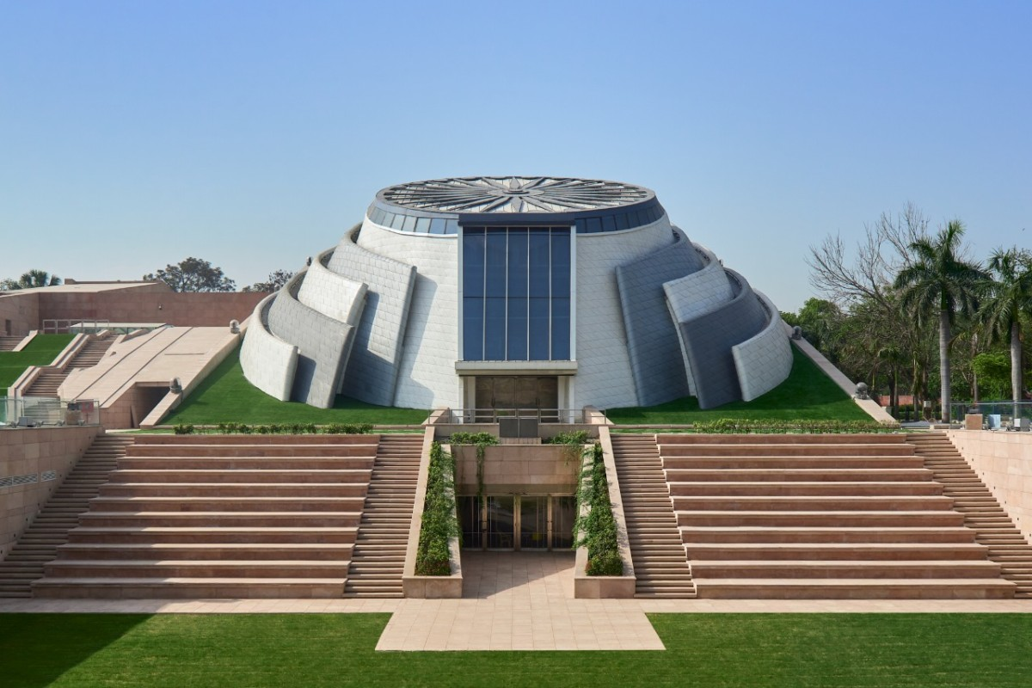
Contents
1
Roadmap to setting up Emerging Tech CoE
2
Potential Offerings
3
Approach - Establishment & Implementation

Slide 3









#1. Roadmap to setting up the Emerging Tech Center of Excellence (CoE)
Vision
Establish a future-ready Emerging Tech Centre of Excellence to transform Pradhan Mantri Sangrahalaya into a global benchmark for AI and AR-enabled cultural preservation, immersive storytelling, and inclusive citizen engagement.
Envision
Future-focused strategy shaping
Validate
Prototype, test, and iterate
Operate
Execute and scale with agility
Enhanced Revenue Streams
Immersive Visitor Experience
Envision
Stakeholder Workshops
Emerging Tech Use Cases Definition
Data and Systems readiness assessment
Innovation Sandbox
Proof of Concept Validation
Conduct Pilot Program
Value Realization Model
Deployment Strategy
Full-scale Implementation
Operate
Validate
Strategy
People
Process
Technology
Execution Pillars of the Emerging Tech CoE
Enhanced Revenue Streams
Responsible AI Governance
Immersive Visitor Experience
Multilingual Voice Interfaces
Inclusive Experience

Slide 4




#2. Potential Offerings
Areas
Description
Interface
Expected Outcomes / Value
Immersive Storytelling through AR in mobile app
AR/VR experience of Pradhanmantri Sangrahalaya through the mobile app
New monetization streams – extension to schools
Enhanced storytelling
1
Mobile App
Multi-lingual voice-based visitor queries
Real-time translation
Speech-to-text and Text-to-speech guides
Mobile App
Integration with audio systems
Inclusive engagement
2
Multilingual Visitor Engagement
Enhanced videos displayed in areas like Helicopter ride and other display areas
Screens in Pradhanmantri Sangrahalaya
Deeper emotional connect
Enhanced user experience
3
Engaging Content
AI-driven insights on visitors to explore new revenue streams
Dashboards
Assess new revenue streams opportunities
4
Visitor Analysis

Slide 5










#3.1. Approach to AI CoE Establishment and Pilot Use Cases Implementation
Phase A: Sandbox Environment Setup & Pilot development - 0 to 6 Months
Hold workshops with museum officials
Identify and define emerging tech use cases
Assess use cases for impact, data readiness, and feasibility.
Set up a secure Sandbox.
Enable controlled PoC development and testing.
Define data flows, integrations, and other layers.
Establish security controls and governance framework.
Develop Proof of Concepts
Validate pilots with concerned departments.
Demonstrate pilots
Incorporate review feedback.
Prepare phased rollout roadmap
A1
A2
A3
A4
A5
Consultation & Use Cases
Sandbox Setup
Architecture & Governance
Pilot / PoC Development
Demonstration & AI Roadmap
Phase B: Full Scale Implementation of successful Pilot Use Cases - 7 to 18 Months
Establish Emerging Tech CoE under Pradhanmantri Sangrahalaya
Define governance structure, roles, and compliance.
Integrate with required Systems
Define cost implications for different deployment strategies
Enable artefacts for providing guidance on deployment strategy
Deploy the use cases along with system integration
Optimize model performance
Scale solutions
Monitor impact using dashboards and KPIs.
Ensure compliance with the required guidelines
B1
B2
B3
B4
B5
Emerging Tech CoE & Governance
Systems Integration
Infrastructure & Hosting
Delivery and Scaling
Monitoring & Compliance

Slide 6
#3.2 Approach to onboarding resources under AI CoE
Open RFP
Empanelment
Parameter | Through RFP |  | Through Empanelment
Onboarding time | 4 Months |  | 1 Month
Quality of Agency | Quality varies due to one-time, cost-driven selection |  | Pre-qualified agencies ensure consistent service quality
Scalability of Scope | Changes in scope require amendment or fresh RFP |  | Scope expandable via work orders without re-tendering
Scalability of Resource | Scaling needs contract modification |  | Rapid resource ramp-up and scale-down possible
M1 to M2
Draft RFP / ToR
M0.5
Scope, eligibility criteria,
Drafting RFP
Department vetting/approval
Scope, evaluation criteria
Department vetting/approval
Invitation to NeGD empaneled agencies
M2 to M4
Bid Management
M1
Prebid meetings, clarifications & Corrigendum's
Technical and Financial bid evaluation
Technical Presentation & Evaluation
Finalizing Agency based on Technical score
# | Resource Position | Role | Experience | Number of Resources | Deployment | Key Activities
1 | Engagement Lead | Advisory | 10+ years | 1 | Full-time | Strategy, government coordination
2 | Functional Expert | Advisory | 3+ years | 1 | Full-time | Use‑case Definition and documentation
4 | AR Developers | Development | 03+ years | 2 | Full-time | Develop AI PoCs and Solutions
5 | AI Developers | Development | 02+ years | 2 | Full-time | Develop AI PoCs and solutions
6 | Full Stack Developer | Development | 03+ years | 1 | Full-time | Handle required integrations and build interfaces
7 | Content Developers | Development | 03+ years | 2 | Full-time | Develop engaging content (videos)

Slide 7


#3.3. Indicative Work Plan
Indicative
Months -> | M1 | M2 | M3 | M4 | M5 | M6 | M7 | M8 | M9 | M10 | M11 | M12 | Ongoing
Design Kick off, Set-up, and Discovery
Define Implementation on agile mode (Phase* 1, 2…N)
Run Measure, Monitor, Optimize, Innovate & Operate
Setup Emerging Tech CoE (onboard diverse pool SMEs)
Client workshop & Governance Model Establishment
Infra setup and access
Assess business & tech landscape
Design Roadmap & Execution Plan (including tech and business choices)
Identify and prioritize use cases (mix of High (H), Medium (M) & Low (L) complexity use cases)
Low complexity
Medium Complexity
High Complexity
(model creation, validation, testing and delivery)
Testing, pilot and roll-out
New improvements
Roll out feedback
Handover
Impact Monitoring
Capacity building | Monitor & measure implementation
Operate
(Duration TBD)
Milestone achievement
* Core AI pod can deliver up to 3-5 use cases, depending on the complexity level

Slide 8
THANK YOU

